Slide 1
2026 : Global Markets opportunities and asymmetric threats
Solidus Securities
Dr. P. Dantis,
Director of Analysis

Slide 2
Contents
Macroeconomic environment
Fed and Central Banks
China
Bonds
Commodities
Stocks
2026 Διεθνείς Οίκοι – Εκτιμήσεις
Solidus Focus List

Slide 3
Macroeconomic environment
Solidus Sec.

Slide 4
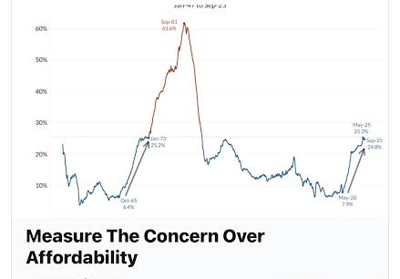
US economic climate
The economic mood in US is bad, despite conventional statistics showing a growing economy , low unemployment and rising wages.
One major reason is that the way normal people look at inflation is very different to the way economists look at. For this reason they will say that inflation is still too high.

Slide 5
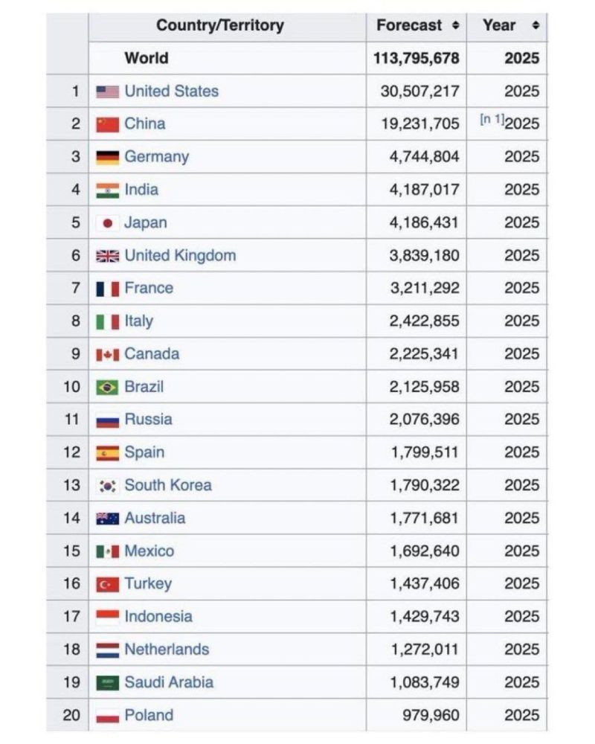
Top 20 economies

Slide 6
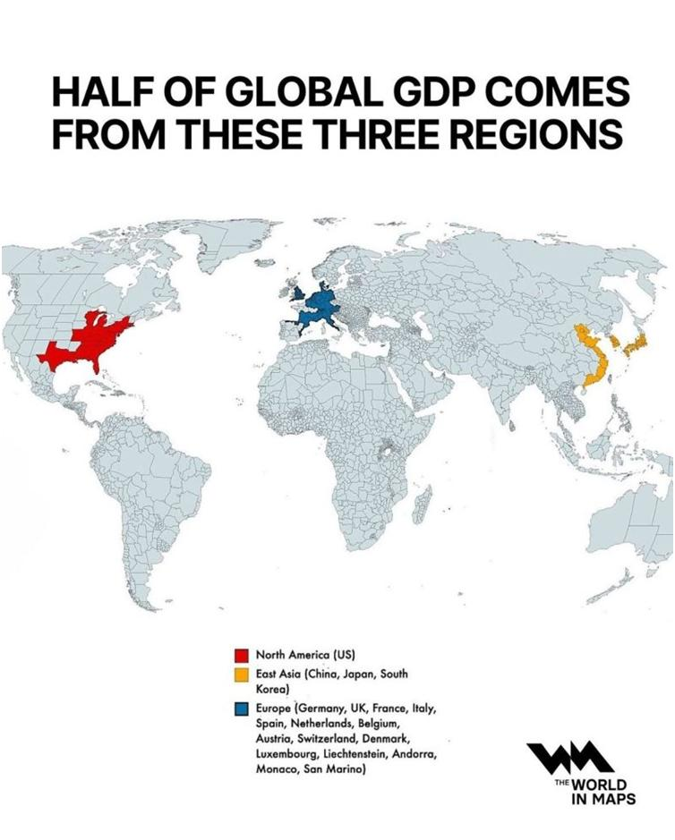

Slide 7
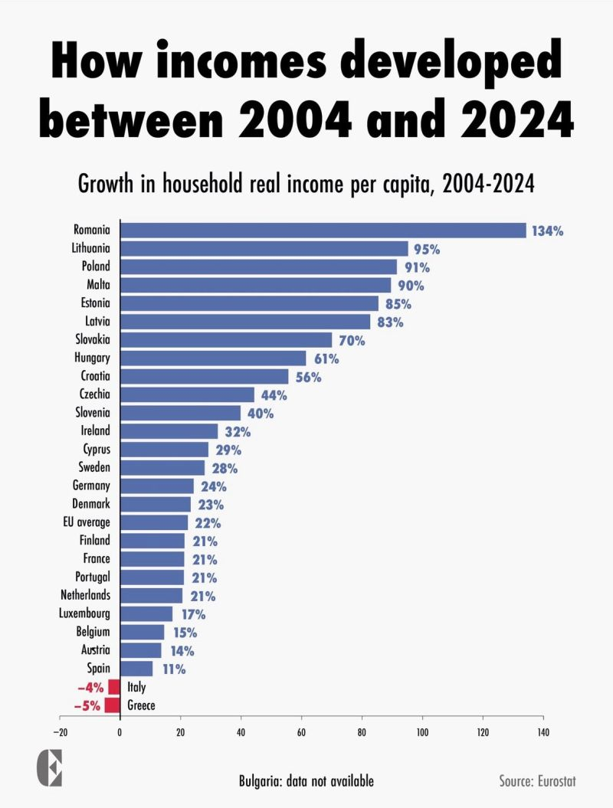
Incomes in Europe 2004 - 2024
Eurostat data shows a strong divergence across Europe between 2004 and 2024.
Eastern European countries lead the continent in real income growth:
Romania (+134%)
Lithuania (+95%)
Poland (+91%)
and others show remarkable progress.
Italy and Greece are the only two countries with negative growth over the same period:
Italy –4%
Greece –5%.
A simple conclusion: some regions are accelerating, while others are standing still.

Slide 8
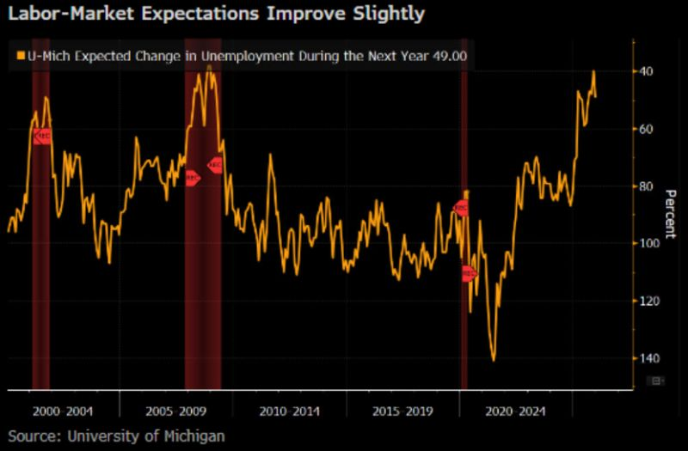
Labor Expectations - Dec.
Consumer sentiment perked up in December now that the government finally reopened
inflation expectations eased a touch
future expectations brightened
current conditions actually slipped
most people still expect unemployment to rise
inflation is viewed as lingering like an unwanted houseguest
In short, the mood has improved, but no one’s breaking out the confetti just yet.

Slide 9
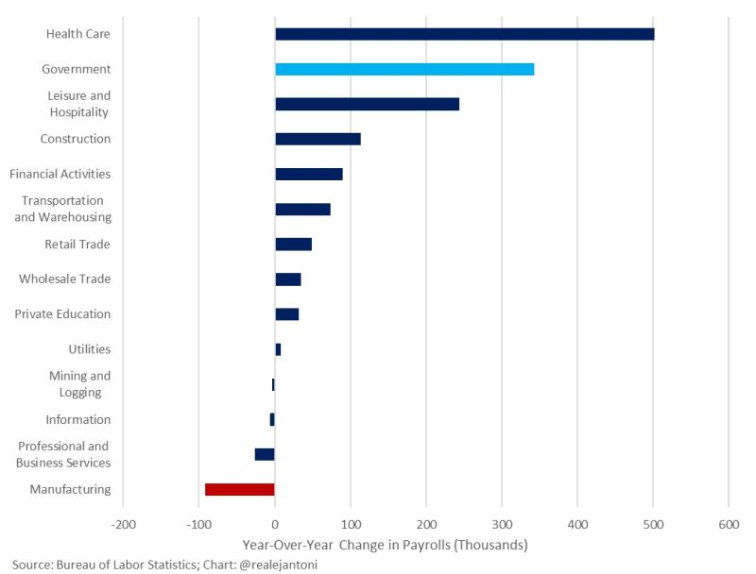
Payrolls : Looks strong , but………
Over the past year, 92% of all job gains have come from just three sectors:
- Health care
- Government
- Social assistance (including elderly care and social security-related roles)
These are the same hiring dynamics observed under President Biden’s administration — a pattern of employment growth dominated by the public sector.
Meanwhile, manufacturing jobs are shrinking, despite being a core focus of President Trump’s economic agenda. Job growth in professional services, technology, and industrials remains limited.
The headline jobs number may suggest strength, but the composition of employment gains tells a different story: the labor market is being propped up by government and government-related sectors rather than broad-based private sector expansion.
Do these job creations create sustainable economic growth?

Slide 10
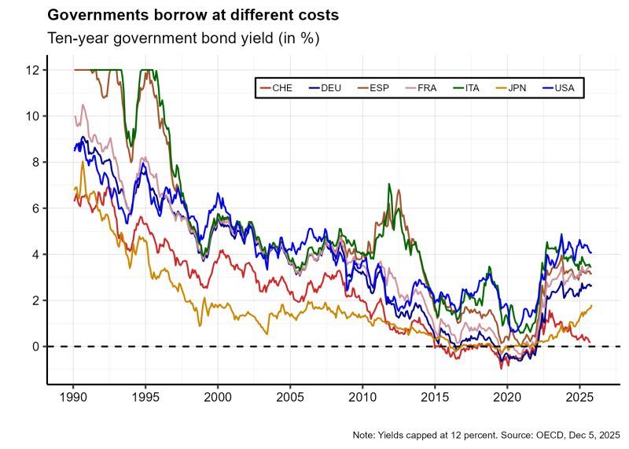
Governments borrow at different costs
The Euro was a gift to high-yield members. Prior to introducing the Euro, Germany paid much lower interest rates on its public debt than Italy or Spain. When the Euro came into being in 1999, Italy benefited so much from the lower borrowing costs that it could have given up its entire value-added tax (Sinn, 2025).
The Euro crisis never ended. Notice how interest rates for the Euro member states never converged again. Germany pays 2.7 percent today, France and Italy 3.5 percent.
France now pays more than Greece or Spain. Recent turmoil in French politics and the huge fiscal gap (5.7 percent compared to Greece's +0.6 and Spain's -2.8) leave a mark.
The US government must pay more for borrowing money than any Euro member state. Markets aren't all too optimistic about the value of the Dollar going forward.
Switzerland has the lowest borrowing costs.
Japan is now on a totally different trajectory.

Slide 11
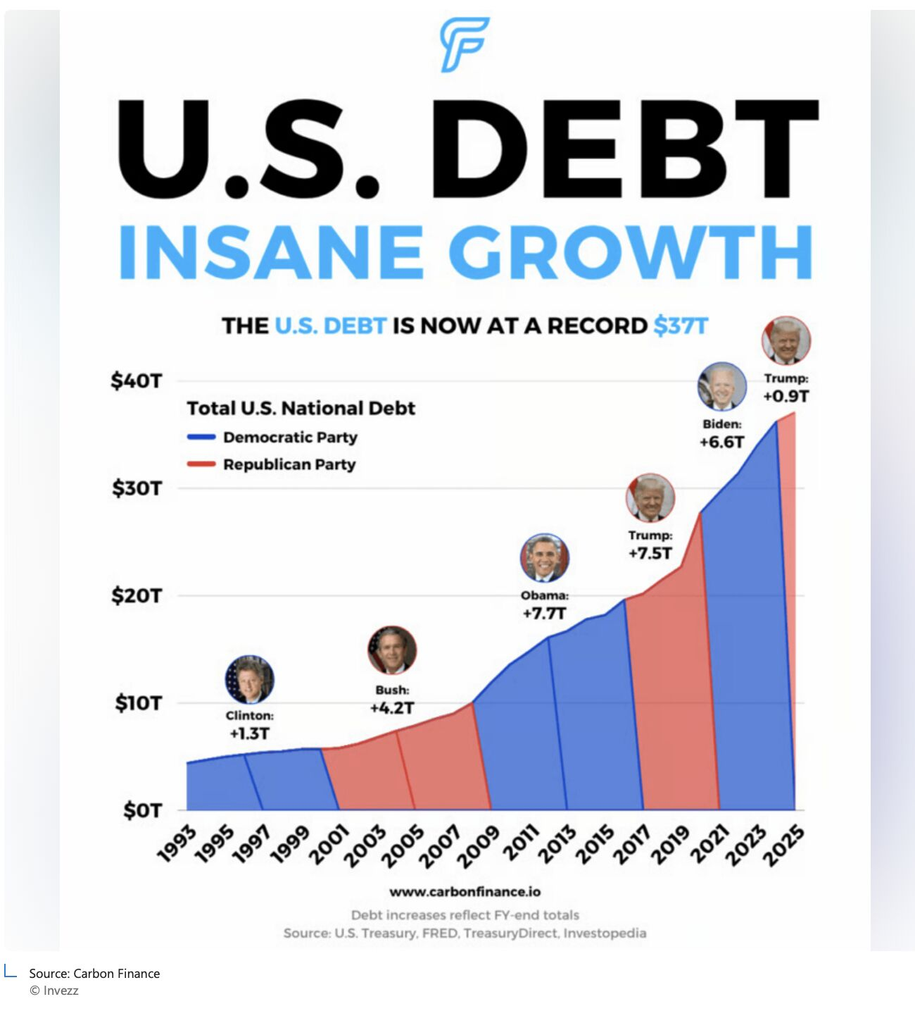

Slide 12
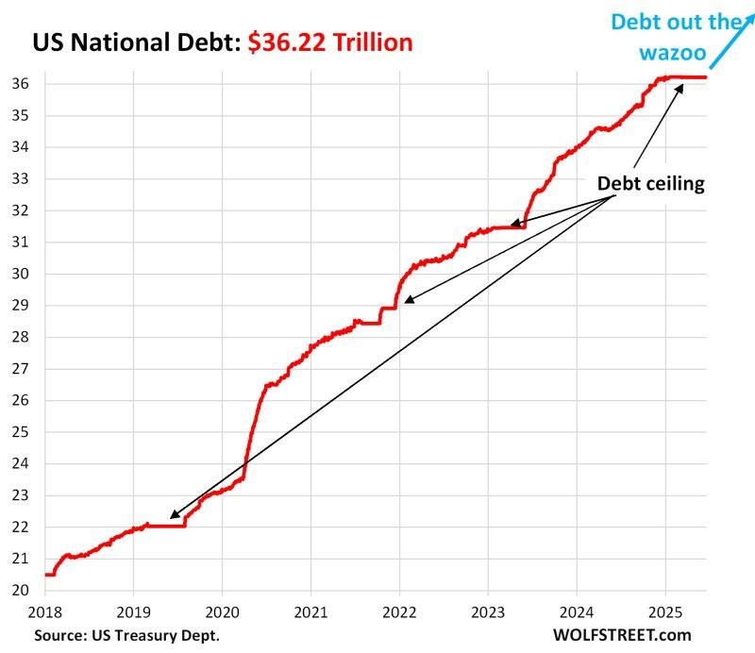
No surpise , the US debt is out of control…

Slide 13
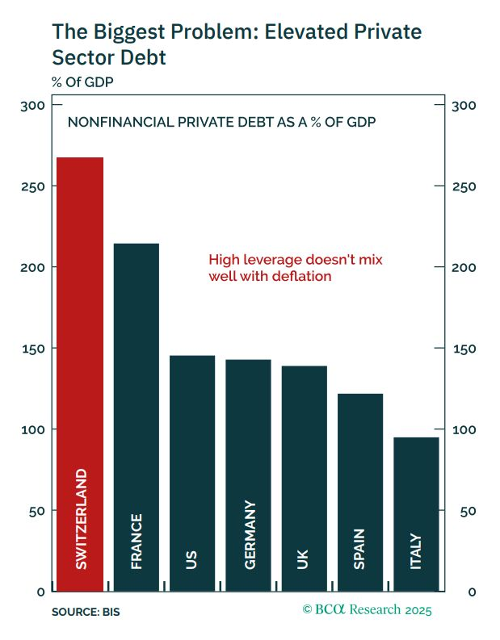
The biggest problem is Private sector Debt

Slide 14

Private debt is peaking…
170% of GDP. That's where US private debt peaked before the 2008 crash.
Neoclassical economists missed it entirely. Why? They believe banks just move money from savers to borrowers. Wrong.
Banks create money when they lend. Credit is aggregate demand. Credit drives the economy.
-0.93 correlation between credit growth and unemployment. Scientists would be disappointed by that number. Economists would kill for it.
Yet mainstream economists published papers confusing debt stocks with credit flows. They literally didn't know what credit was.
The next crisis is building. Private debt is the bomb. Government debt? That's not the problem.

Slide 15
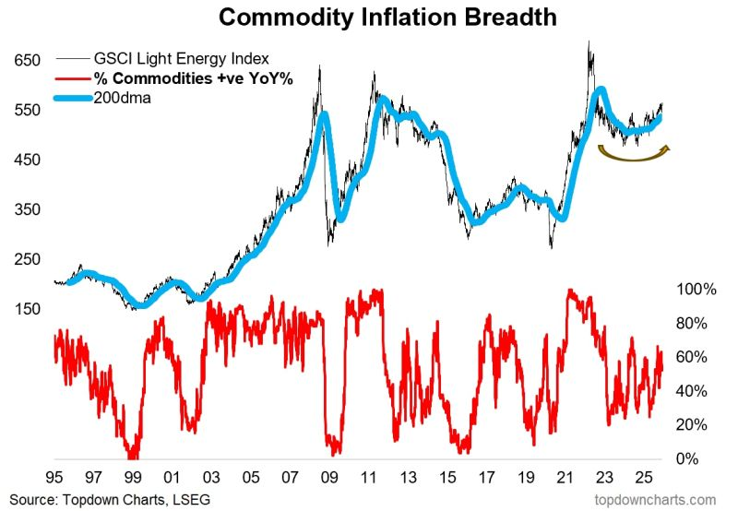
Commodity Inflation Breadth
Commodity Inflation Breadth Is Stabilizing
while commodity prices aren’t surging, the breadth of commodities showing year-over-year gains has been quietly firming. Historically, that tends to happen at inflection points in the global cycle, not at the peak of inflation.

Slide 16
Commodity Inflation -2
1. This isn’t broad inflation — it’s stabilization.
Commodity breadth rising from deeply negative levels usually signals that price declines are slowing across the complex. It’s a normalization phase, not a reacceleration of inflationary pressure.
2. Energy isn’t driving the story this time.
Oil remains soft and highly sensitive to growth expectations. The breadth improvement is coming instead from industrial metals and some agricultural markets, consistent with early signs of a global restocking cycle.
3. The macro backdrop supports a gentle turn, not a spike.
With central banks now shifting toward rate cuts in 2025, and China stabilizing manufacturing output, the setup favors firmer demand but not the explosive commodity dynamics of 2021–22.
4. Markets often look through this before it shows up in the data.
Historically, when breadth stops deteriorating and begins climbing, commodities tend to perform more consistently — especially metals tied to investment cycles and energy transition spending.
This chart isn’t shouting “inflation is back.” It’s saying that the commodity complex is quietly finding a floor.
In a world where inflation volatility is finally fading, breadth turning higher is less about overheating and more about the global economy moving out of its soft patch.

Slide 17
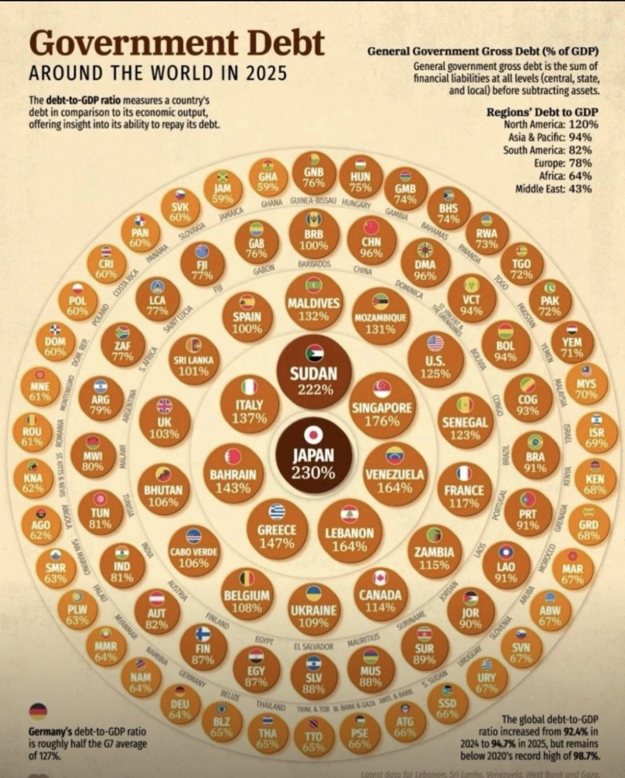
Government Debts
As Debt /GDP ratios continue to swell, servicing them is getting more expensive
More than 3.5b people live in countries where net interest payments on public debt exceed education or health funding.
The graph shows the counties with the highest debt/gdp ratios in 2025 based on data from IMF.
Japan is the leader with 230%
War torn Sudan follows next with 222% and Singapore with 176%
In EU. Greece has 147% , nearly double the region’s average
Italy follows with 137%
US ranks 11th - the current federal budget adds 1.8 trillion each year to the 38 trillion debt. Debt ratio is 125%

Slide 18
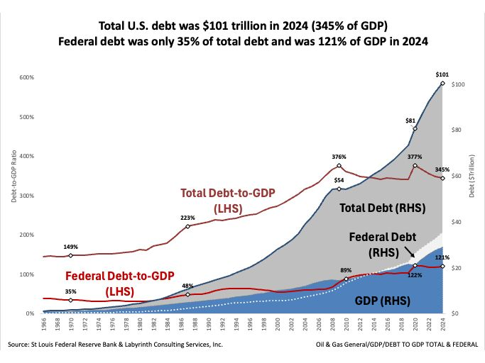
Public Debt is only a fraction of the problem

Slide 19
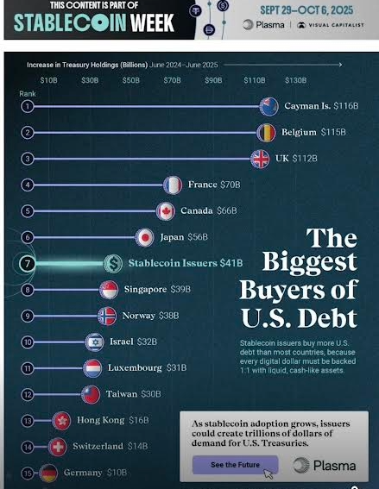
New Buyer of US Debt : Stablecoins
The US has found a new buyer for its debt : stablecoins
In the last 12 months , stablecoins issuers bought 41B of US debt.
That's more than Germany, Taiwan or Switzerland over the same period
This demand isnt driven by macro traders or sovereign funds, but by users minting digital dollars.
Every new stablecoin minted must be backed 1:1 with safe , liquid assets.
Which means stablecoin adoption = built in Treasury demand engine.
This is no longer a “crypto tool”.
US Treasury forecasts $ 3T in stablecoin supply by 2030 !

Slide 20
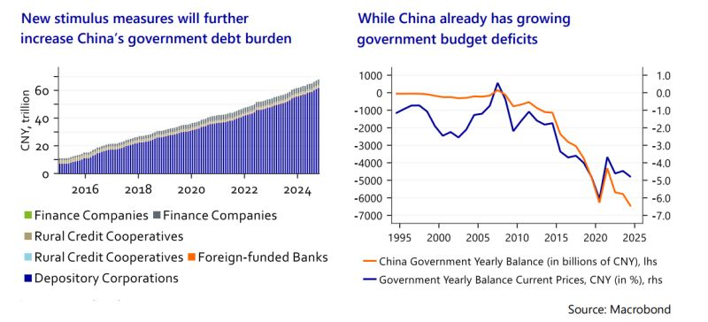
Who wastes more public money and piles more debt ?

Slide 21
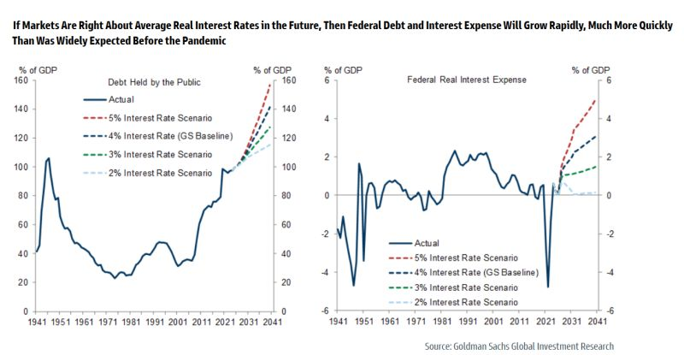
US Fiscal Sustainability - the cost on doing nothing

Slide 22
Fed and Central Banks
Solidus Sec.

Slide 23
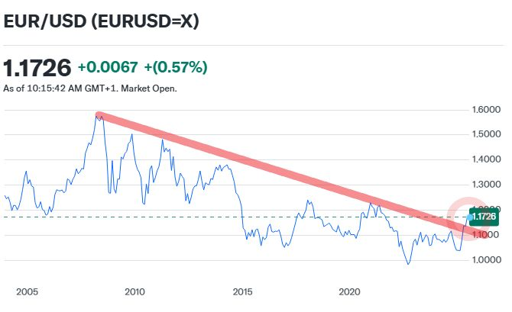
Euro changed trend

Slide 24
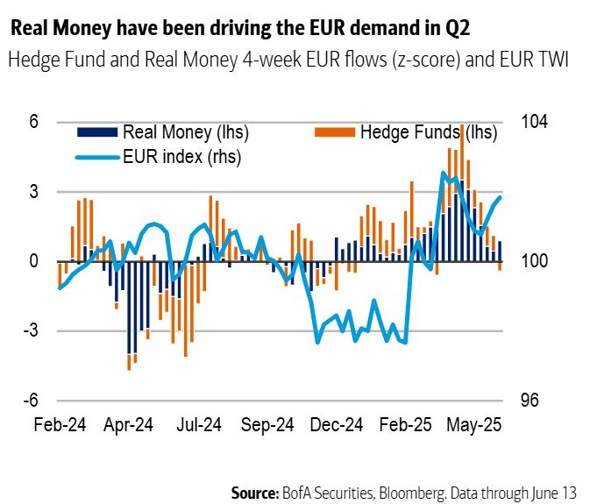
Real money chasing Euro

Slide 25
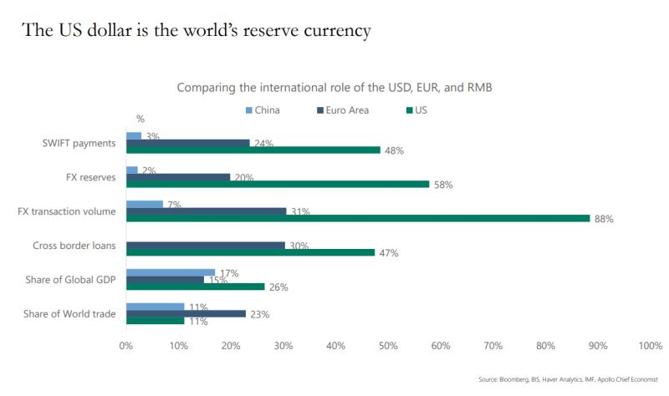
USD is still the world’s reserve currency

Slide 26
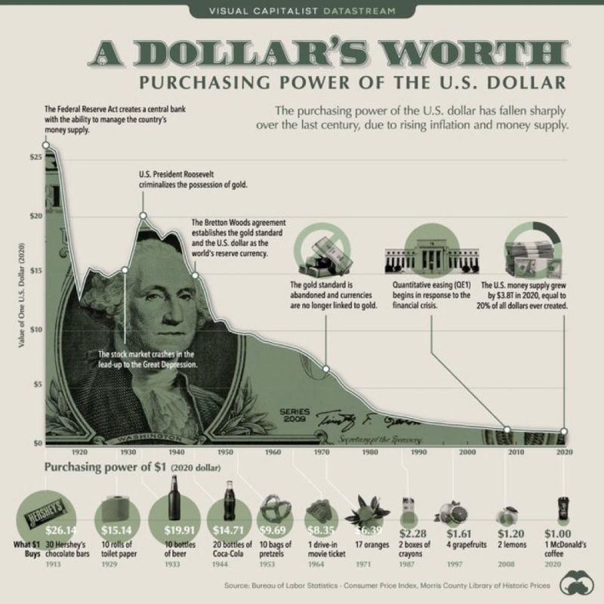
USD - A CENTURY OF DECLINE
Key inflection points:
• 1913: Creation of the Federal Reserve.
• 1933: Gold ownership criminalized by Roosevelt.
• 1971: Nixon ends gold convertibility, decoupling the dollar from hard assets.
• 2008 onward: Massive monetary expansion through QE, accelerating the decline.
In 1913, $1 could buy 30 Hershey bars. Today? Barely a McDonald’s coffee.

Slide 27
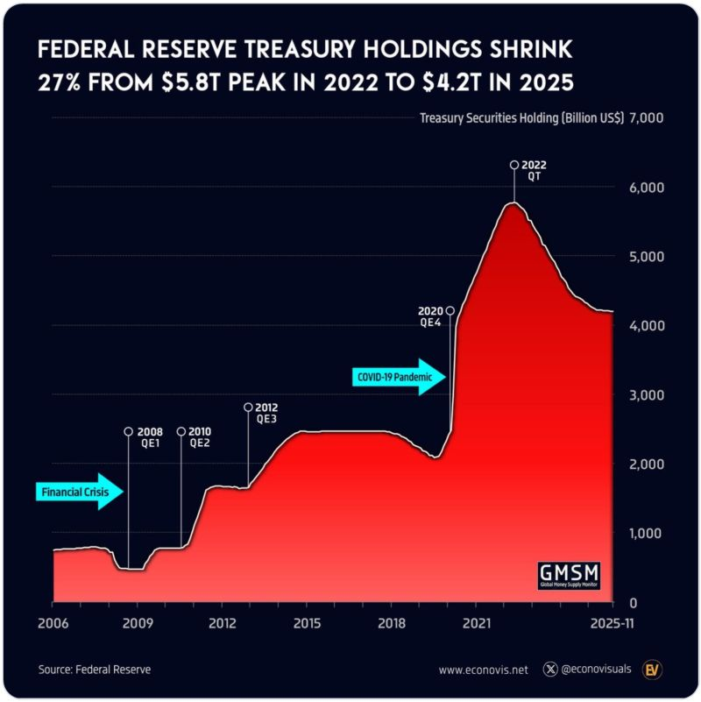
Fed’s Treasury Portfolio
The Federal Reserve’s treasury holdings climbed 133% (!) during the COVID crisis, rising from 2.5 trillion in February 2020 to a peak of 5.8 trillion USD in May 2022.
But since mid-2022, the Fed has steadily reduced its treasury portfolio, which fell by 1.6 trillion (-27%) to 4.2 trillion USD by November 2025.
The pace of runoff has eased in recent months: the year-over-year decline slowed from -8% in March to -3% in November 2025, with holdings effectively stabilizing around 4.2 trillion USD.

Slide 28
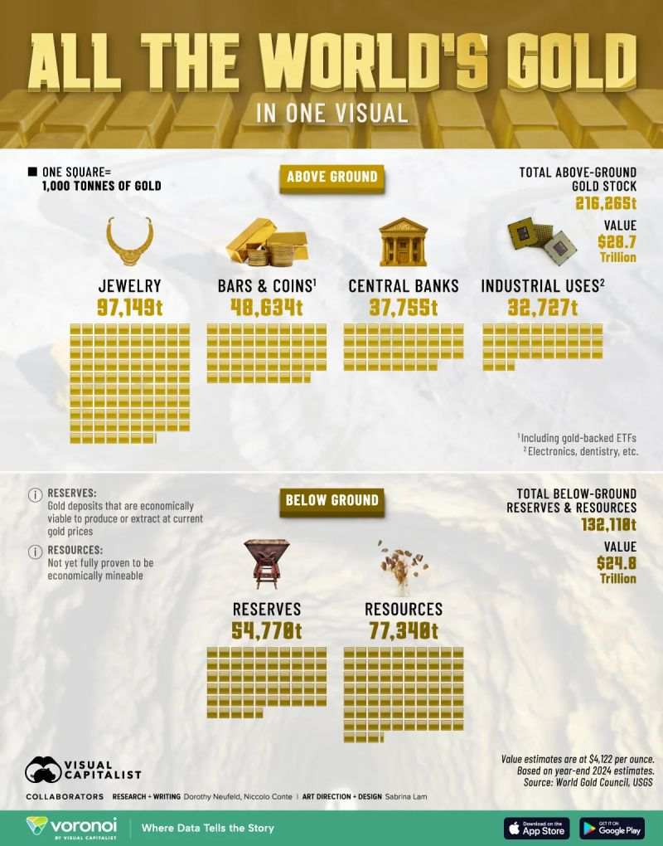
Central Bank GOLD accumulation
There is a widening divergence between central bank net purchases and net sales of gold in 2025
China, India, Türkiye and the UAE continued net accumulation through Q1 and Q2 2025
correlated to domestic currency weakness vs USD
Hedging role of Gold
Are Strategic positioning in a de-dollarization equilibrium
In contrast, Russia entered a rare divestment phase. For the first time, the Central Bank of the Russian Federation began selling physical gold from its reserves to support Finance Ministry budget operations. Russia retains over 2,300 tons, the fifth largest global stock
The National Wealth Fund (NWF) has reduced its gold from 405.7 tons pre-2022 to 173.1 tons by November 2025 to stabilize ruble , ease pressure on yuan reserves and diversify reserves.
These patterns reaffirm gold's evolving role in a multipolar reserve enviroment, where official institutions leverage accumulation, selective sales and upstream sourcing to navigate an increasingly complex global monetary order.

Slide 29
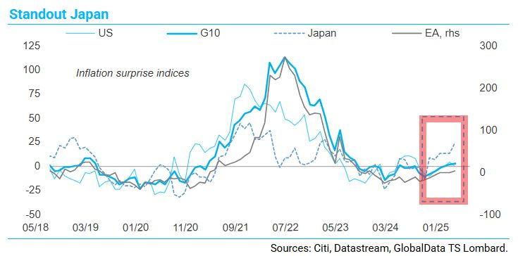
The inflation is in JAPAN now..

Slide 30
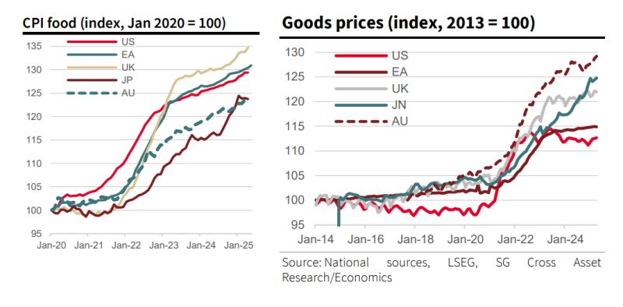
Deflation ? NO WAY
Forget the nonsense, the stuff is and remains expensive ...
... naive economists (especially in the ivory towers, but also elsewhere) and superficial journalists allow themselves to be fobbed off with slightly lower annual rates of change, while consumers are regularly shocked by the high prices on their receipts (or by the unattainable real estate prices driven up by the Keynesian cheap money of recent years) ...

Slide 31
China
Solidus Sec.

Slide 32
Κίνα – εμπορικό πλεόνασμα $1.08 τρις
Ρεκορ όλων των εποχών όλων των χωρών σε 11 μήνες.
Το εμπορικό πλεόνασμα της Κίνας σε αγαθά και υπηρεσίες ξεπέρασε το 1 τρισεκατομμύριο δολάρια μέσα σε 11 μήνες, φτάνοντας τα 1,08 τρισεκατομμύρια έως τον Νοέμβριο.
Οι δασμοί των ΗΠΑ οδήγησαν σε μείωση των κινεζικών εξαγωγών προς τις ΗΠΑ, αλλά η Κίνα αντιστάθμισε μειώνοντας τις αγορές αμερικανικών προϊόντων, διατηρώντας τριπλάσιο πλεόνασμα.
Η Κίνα ενίσχυσε τις εξαγωγές της σε αυτοκίνητα, ηλιακούς συλλέκτες και ηλεκτρονικά σε Ασία, Αφρική, Ευρώπη και Λατινική Αμερική, ανταγωνιζόμενη παραδοσιακές βιομηχανικές δυνάμεις.
Η Κίνα παρακάμπτει εν μέρει τους δασμούς Τραμπ μεταφέροντας τη συναρμολόγηση προϊόντων σε άλλες χώρες, ενώ το ασθενές γουάν και οι χαμηλές τιμές ενισχύουν τις εξαγωγές της.
Αξιωματούχοι του ΔΝΤ επισκέπτονται την Κίνα για να εξετάσουν τις πολιτικές της, ενώ οικονομολόγοι προτείνουν ανατίμηση του γουάν για την ενίσχυση της εγχώριας κατανάλωσης, παρά τον κίνδυνο για τους εξαγωγείς.

Slide 33
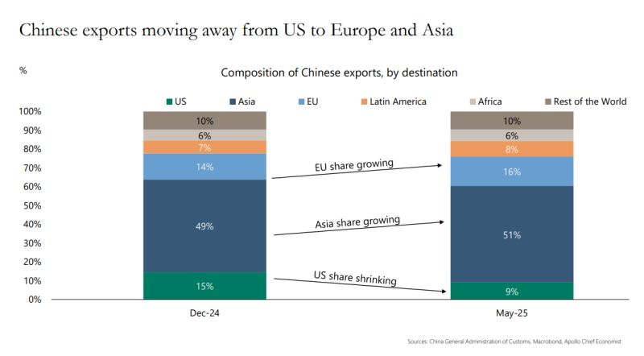

Slide 34
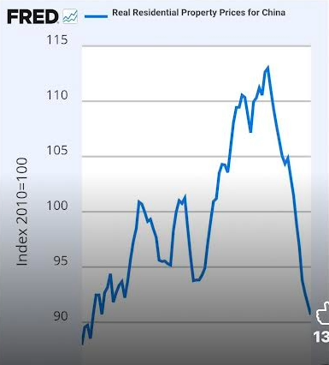
China : Residential Property Prices
Severe decline that could trigger recession if Central Authorities ignore.

Slide 35
Bonds
Solidus Sec.

Slide 36
Bonds vs Stocks
The most important market in the world is signaling that inflation is returning to the financial system.
sovereign/ government bonds are THE bedrock of the current financial system. Indeed, the yields on these bonds represent the “risk free” rate of return against which all risk assets (including stocks) are valued
Put simply, BONDs, not stocks, are THE asset class to watch for clues as to what is coming down the pike
The financial media (and most investors) like to focus on stocks because they are a volatile asset class and this volatility potentially translates to making a LOT of money quickly.
The global stock market is about $80 trillion in size. By way of comparison, the debt/ bond market is over $300 trillion in size.

Slide 37
Bonds Are Signaling Something MAJOR is Coming
the bond market is signaling that inflation is coming.
The yield on the 10-Year Japanese Government bond is going parabolic
Japan is the grandfather of monetary policy insanity having first introduced insane policies like Zero Interest Rate Policy (ZIRP) and Quantitative Easing (QE) a decade before the Fed or anyone else.
it makes sense that Japan is the first country to lose control of its bond market.
Japan is not alone. The yield on Germany’s 10-year Government Bond is also turning up signaling that inflation is returning to that financial system as well
This is deeply concerning because the European Central Bank is in fact cutting rates… and the yield is going UP instead of down (the ECB is easing into another inflationary storm).
The Fed has already cut rates twice this year. And the yield on the 10-Year U.S. Treasury is refusing to break down

Slide 38
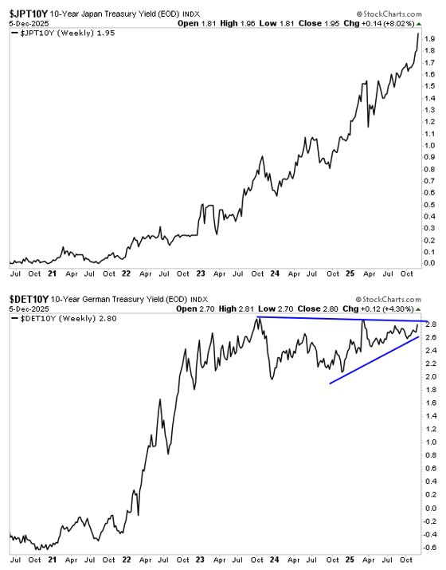
Bond Market signals inflation is returning
The Fed has already cut rates twice this year. And the yield on the 10-Year U.S. Treasury is refusing to break down
it’s coiling in a triangle formation, preparing for a violent breakout
Given what is happening in Japan and Germany, the odds are that this breakout will be UP… meaning bonds are breaking down again.
Put simply, THE most important market in the world (bonds) is signaling inflation is returning to the financial system.

Slide 39
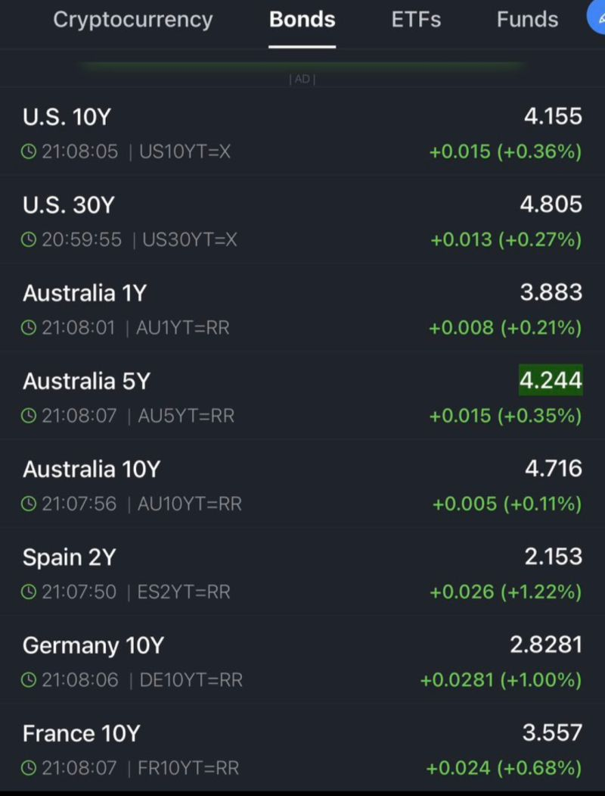
When yields rise ..
U.S. 10Y is going up.
U.S. 30Y climbing.
Australia’s 5Y and 10Y pushing in new highs.
Germany, France, Spain, all drifting higher at the same time.
Governments pay more.
Corporations pay more.
Housing slows.
Credit tightens.
Consumers pull back.
Emerging markets get crushed.
None of this hits instantly, it stacks. Slowly. Quietly. Then suddenly
This is exactly how downturns start: not with a crash, but with a slow, boring climb in yields that everyone ignores because stocks are still pumping.
Investors are busy arguing about AI, flipping memecoins, or celebrating new ATHs, the bond market is quietly tightening the screws on the entire system.

Slide 40
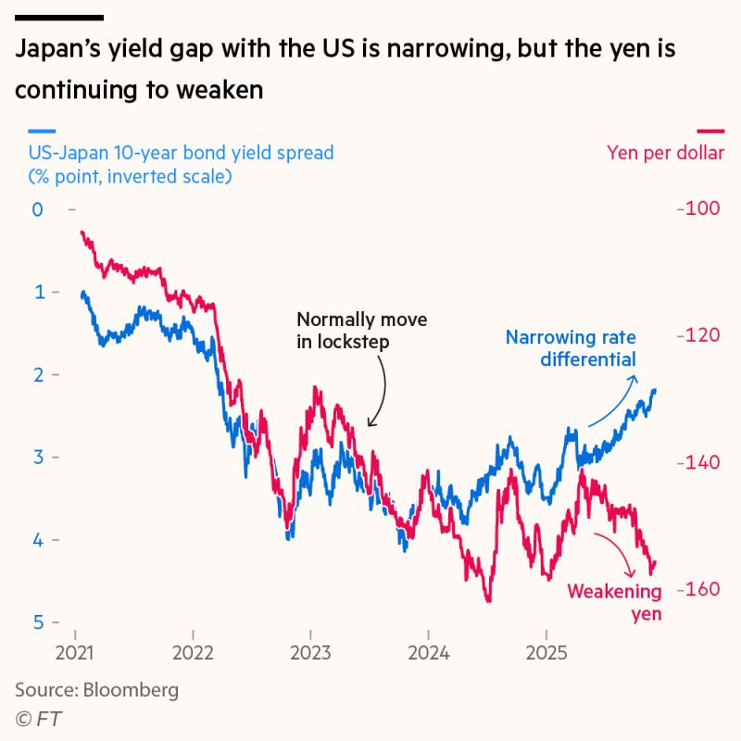
Japan’s yield gap
Dollar-yen movements typically follow the US-Japan bond yield spread, but this relationship has reversed since April. Japan’s 10-year yield is approaching 2 per cent, the highest point since 2007, while the US 10-year has stayed just above 4 per cent. Yet instead of appreciating, the yen continues to weaken against the dollar. The old pattern may re-emerge next year as data support higher rates, but the BoJ faces a difficult path as a steeper yield curve raises its interest-payment burden.

Slide 41
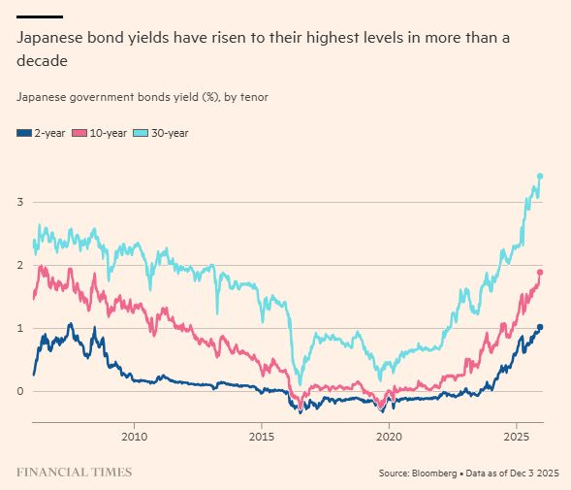
Japanese Bond yields @ record levels
Japanese yields have progressively risen in the last year to levels not seen in nearly one and half decade (and more for the 30 year yields).
Sovereign borrowing and indebtedness are increasingly a focus of astute investors, and in our view should be a risk metric to be monitored by all investors.
Further rise in longer dated rates in Japan and/or globally could test both the leverage in the system similar to 2020 (many hedge funds have leverage bond "basis trade" positions), and the carry trade to the extent that some investors hold positions.

Slide 42
Yields, Germany
German 30-year yields are sitting at their highest levels in more than a decade
The move above 3.4 percent marks a structural shift in Europe’s rate environment :
Fiscal policy is no longer anchored to the old European model.
Germany’s constitutional debt brake has been repeatedly softened through special funds and rulings, and markets now expect structurally higher issuance of long maturities to finance defence, energy transition and industrial support. More supply at the long end means upward pressure on yields.
The ECB’s “high for longer” stance is being priced in.
Even with disinflation progressing through 2024–25, ECB officials have been explicit: policy rates are not going back to the zero-rate era. The term premium — which was negative for years — has normalised and is still rising.
Europe’s growth picture has shifted.
The eurozone is not booming, but the recession fears of 2023–24 have faded. That reduces safe-haven demand for long-dated Bunds. At the same time, capital expenditure for energy infrastructure and onshoring continues to lift long-term investment needs.
Global bond markets are more interconnected than before.
Higher long-term US yields (driven by deficits, supply and a repricing of the neutral rate) have spilled over into European curves. Bunds are no longer trading in isolation — they are reacting to global term-premium repricing.
MEANS : A world of structurally higher term premia, larger fiscal footprints and persistent investment demands creates a very different backdrop for Europe’s long-duration assets.

Slide 43
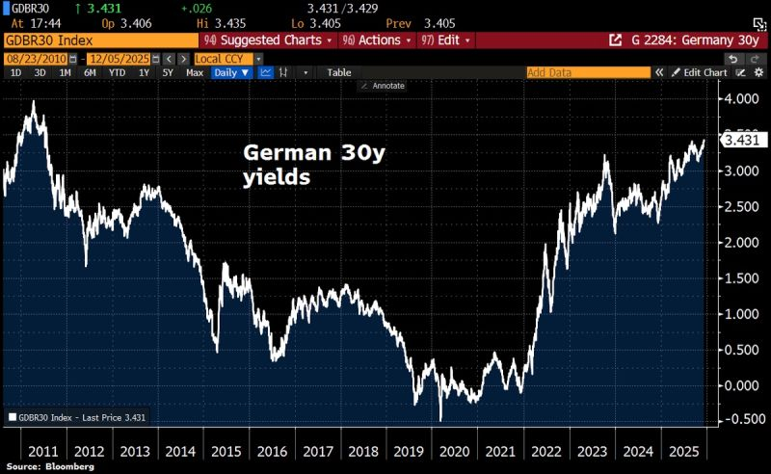
German 30y yields

Slide 44
Yield Gap is narrowing
Dollar-yen movements typically follow the US-Japan bond yield spread, but this relationship has reversed since April. Japan’s 10-year yield is approaching 2 per cent, the highest point since 2007, while the US 10-year has stayed just above 4 per cent.
Yet instead of appreciating, the yen continues to weaken against the dollar.
The old pattern may re-emerge next year as data support higher rates, but the BoJ faces a difficult path as a steeper yield curve raises its interest-payment burden

Slide 45
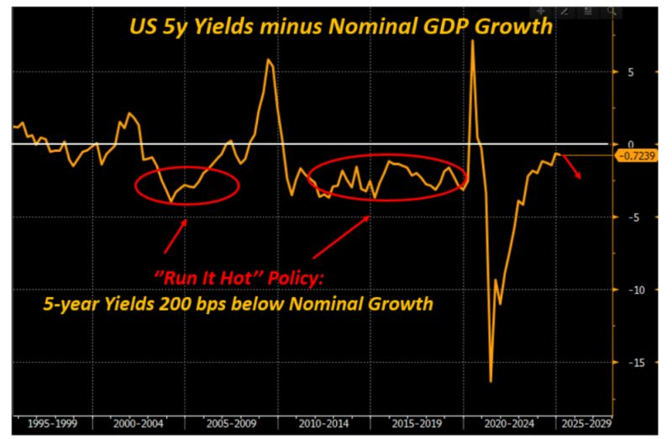
US 5y Yields – Nominal GDP Growth

Slide 46
Commodities
Solidus Sec.

Slide 47
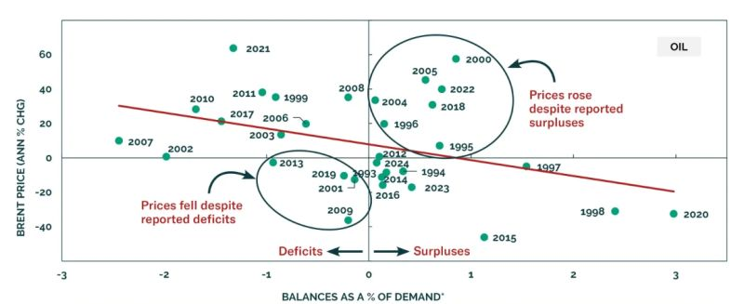
Brent prices : balances are an overrated gauge unless surplus or deficit exceeds about 1% of global demand

Slide 48
Higher Henry Hub Gas prices may start to impact EU gas prices
US gas prices, on the other hand, have risen sharply. Since mid-October, Henry Hub has increased by 80 percent and is now at its highest level since December 2022.
Cold weather across large parts of the US is pushing prices higher. Still, underlying demand is also strong, driven by LNG feedgas demand and rising gas consumption to support the enormous energy demand triggered by AI technologies.
Historically, there has been a relatively high positive correlation between US Henry Hub prices and European TTF prices.
The rise in US gas prices, therefore, represents a clear upside risk for European prices.
The high US gas prices also exacerbate inflationary pressures
The developments worsen the affordability crisis in the US - a theme that will be crucial ahead of mid term – elections
Hence, with Trump in office, it cannot be ruled out that the US may restrict LNG exports to keep domestic prices down.
This is becoming a potential risk for European gas prices in the coming years that should not be ignored

Slide 49
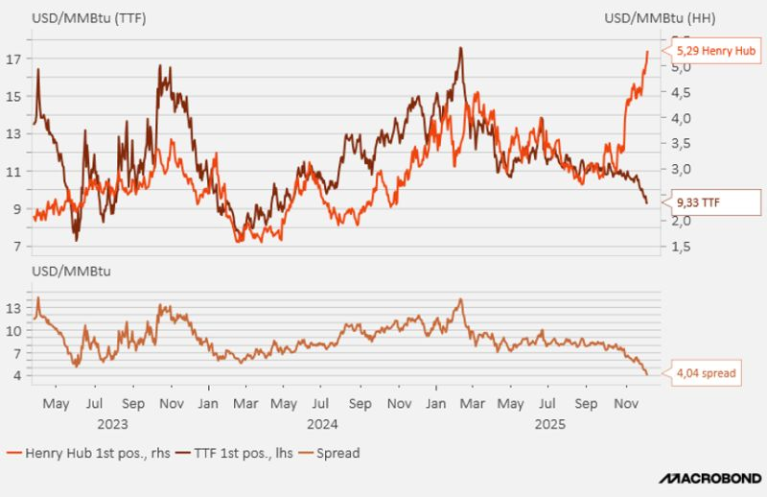
HH vs TTF

Slide 50
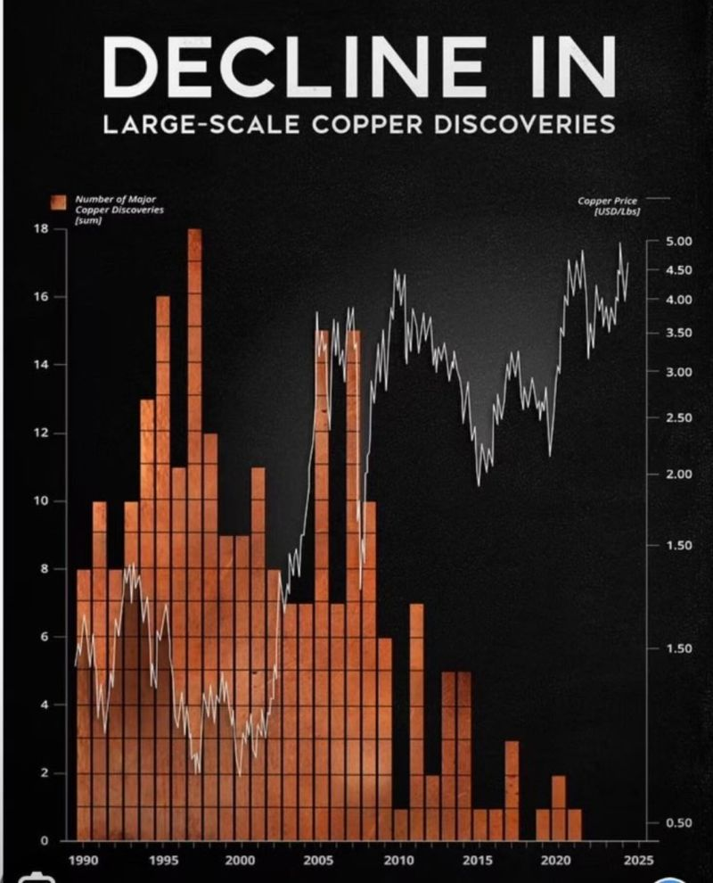
Copper : decline in large scale discoveries => bull market ahead ?
You can’t electrify the world without copper and the world is running out of it.
Large-scale copper discoveries are down 90% over the last two decades
Copper deficits are projected to widen through 2030
Copper demand is surging: driven by electrification, data centers, and AI
It takes 20+ years from discovery to first production
How far can this copper bull market run?

Slide 51
Stocks
Solidus Sec.

Slide 52
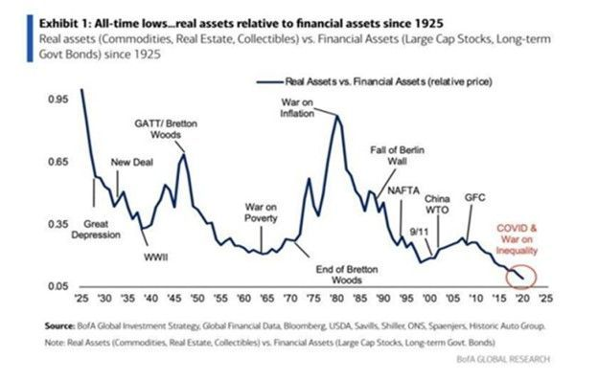
Real assets vs Financial assets
Real Assets : Commodities, Real Estate, Collectibles
Financial Assets : Large Cap Stocks, Long Term Government Bonds
For Long Term Investors only
The chart from Bank of America Global Research shows real assets (commodities, real estate, and collectibles) relative to financial assets (large-cap equities and long-term bonds) since 1925.
The message is clear: real assets are now near their lowest relative valuation in nearly 100 years
Historically, such extremes have marked turning points : The Great Depression, the end of Bretton Woods, and the inflationary 1970s all saw periods when real assets surged after being deeply undervalued.
Each shift corresponded to a broader change in macro conditions, from disinflation to inflation, from financial engineering to tangible value creation.
After four decades dominated by falling interest rates, globalization, and technological efficiency, financial assets have vastly outperformed. But those tailwinds are fading. Rising geopolitical risk, deglobalization, fiscal expansion, and resource scarcity all tilt the balance back toward the physical and finite.
If history rhymes, the next cycle may favour commodities, infrastructure, and other real assets — sectors long dismissed as “old economy” but now central to a world rebuilding supply chains and national resilience.

Slide 53
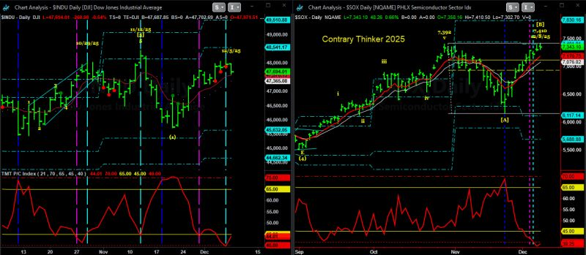
Tops and Bottoms in markets
bottoms are events; tops are processes
Bottoms : fast, emotional, unmistakable if you’re not trapped in the fear
Tops : rarely form in a single dramatic moment. They dissipate. They require multiple attempts, repeated failures, and a sequence of exhaustion signals: the double top, the triple top, the “one more marginal high.” These are the norm, not the exception.
Tops demand context, volatility, and time. Without those lenses, the process is invisible until it is too late.
Both the Dow and the Semiconductor Index are tracing out their highs again. We have caught several of their peaks in 2024 and 2025—each short-lived, each followed by renewed recoveries.

Slide 54
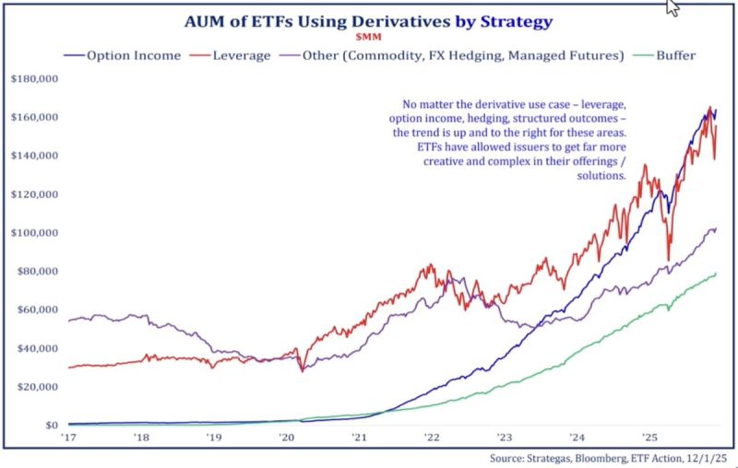
Fastest growing ETFs: Derivatives based Strategies
Option-income ETFs
leveraged exposures buffers
commodity/FX hedging products assets have climbed sharply since 2021.
Option-income ETFs in particular have exploded from almost nothing five years ago to well over $150 billion today.
Leverage products have also grown meaningfully, even with periodic pullbacks.
This growth is being driven by two forces:
investor demand for targeted outcomes in a volatile macro environment, and
the ETF industry’s ability to package increasingly complex exposures in low-friction, liquid vehicles.
The takeaway is straightforward: innovation has opened the door to far more tools than most investors had access to a decade ago. But as allocations rise, understanding the mechanics behind these strategies becomes just as important as the exposures themselves.

Slide 55
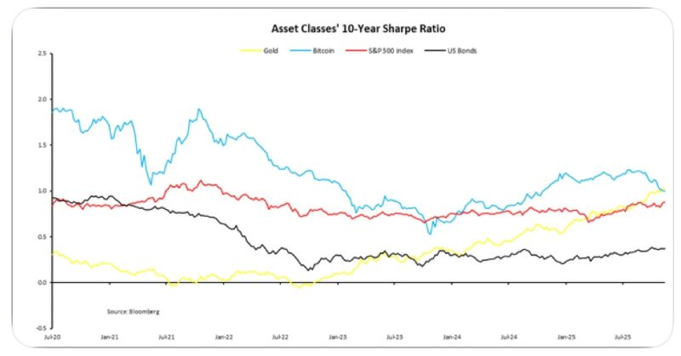
Asset Classes’ 10 year Sharp Ratio
10 year Sharp ratios:
Gold: 1.03
Bitcoin: 1.00
US stocks: 0.88
US bonds: 0.37
Gold now with the highest 10-year Sharpe ratio amongst major asset classes
We have entered a new regime = > Lot to think about asset allocators

Slide 56
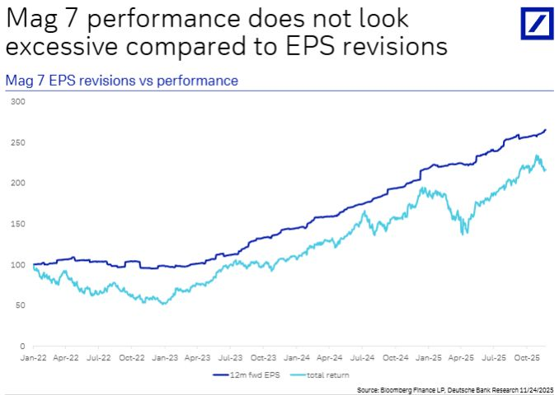
Is there a Bubble ?
US stocks were up “only” 20% from 1 January to their peak in late October, underperforming most other major equity markets this year.
So far, in recent years, earnings revisions have supported the strong equity performance of the leading Mag7 companies
Earnings have actually grown faster than share prices, meaning valuation multiples have declined over that period.
Unless we begin see meaningful negative earnings revisions and profit warnings, I would find it difficult to make a broad bearish call on markets -especially in an environment of declining interest rates and inflation.

Slide 57
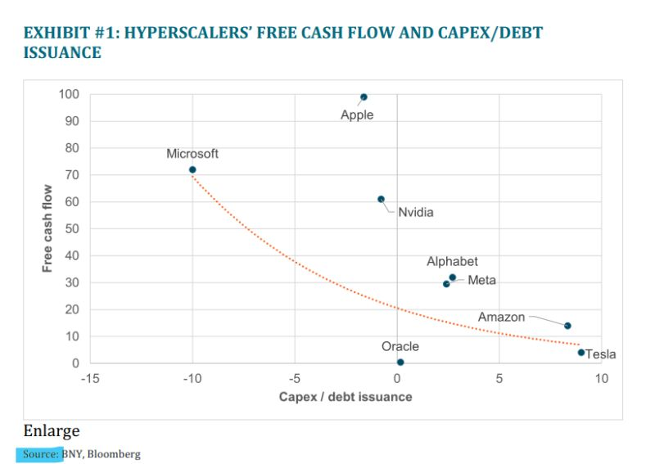
How M-7 are paying the AI revolution :
Hyperscalers’ Free Cash Flow and Capex/Debt
The playbook is simple: Free Cash Flow OR... massive debt. (Look at Oracle's recent debt noise—it's a leading indicator).
The Mag 7 (ex-Tesla) forward P/E is nearly 30x. That's nowhere near "value investor comfort."
The pace of this AI buildout is directly tied to two things: Future Earnings and the Cost of Capital.
If Margins Drop or Borrowing Costs Rise, the AI investment boom must slow down.
That deceleration hits U.S. GDP hard.
The feedback loop's timing will dictate how the entire equity market trades.
The core question isn't whether AI is real—it's whether the current investment pace is sustainable until the returns finally justify the spending. This is the true AI bubble concern.
Are we watching a self-sustaining cycle, or an investment spree built on borrowed time (and borrowed money)?

Slide 58
The real problem of AI booming is …
The playbook is simple: Free Cash Flow OR... massive debt. (Look at Oracle's recent debt noise—it's a leading indicator).
The Math That Makes Value Investors Sweat:
The Mag 7 (ex-Tesla) forward P/E is nearly 30x. That's nowhere near "value investor comfort."
The market is demanding a clear ROI by 2026.
The pace of this AI buildout is directly tied to two things: Future Earnings and the Cost of Capital.
The Domino Effect:
If Margins Drop or Borrowing Costs Rise, the AI investment boom must slow down.
That deceleration would hit U.S. GDP hard.
The core question isn't whether AI is real—it's whether the current investment pace is sustainable until the returns finally justify the spending. This is the true AI bubble concern.
Are we watching a self-sustaining cycle, or an investment spree built on borrowed time (and borrowed money)?

Slide 59
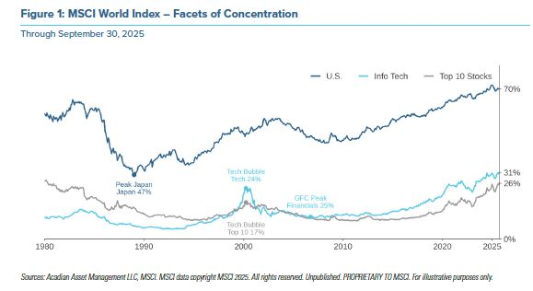
MSCI World Index : 70% is US stocks
The MSCI World Index, which serves as the lodestar for institutional allocation, is no longer a truly global representation. It has morphed into a proxy for the United States large-cap growth market with minor regional satellites attached.
This concentration has reached historic extremes. The United States now constitutes approximately 70 per cent of the index weight. To place this in historical context, this exceeds the dominance Japan held during its bubble peak in the late 1980s, which topped out at 47 per cent

Slide 60
Bull and Bear : 8 decades of data reveal
The average S&P 500 bull market since 1949 has lasted 5.3 years, delivering a cumulative return of +254%
while the average bear market has lasted just 1.0 year, with an average decline of 31%.
Late in bull markets , investors assume gains are permanent. Late in bear markets, they assume declines will last indefinitely
Yet the historical record tells a different story : Even the most severe contractions are brief relative to the multi-year expansions that follow
Today : The latest bull phase is ageing, leadership is narrowing, and valuations in key sectors are stretched.
Yet history suggests that the next meaningful period of volatility, whenever it arrives, will likely be short-lived relative to the expansion that follows.
.
The 12.3-year bull market beginning in 1987 delivered +841%.
The post-2009 expansion ran for 11 years and returned +527%.
These cycles were punctuated by sharp declines, some lasting only months, but the underlying trend remained upward.
Long expansions compress risk premia, push valuations higher, and narrow leadership
Short contractions reset those conditions, often violently, creating the foundations for the next cycle.
The challenge is behavioral. Humans overweight recent experience, and during the worst months of a downturn, it rarely feels like the beginning of a new long-term advance.

Slide 61
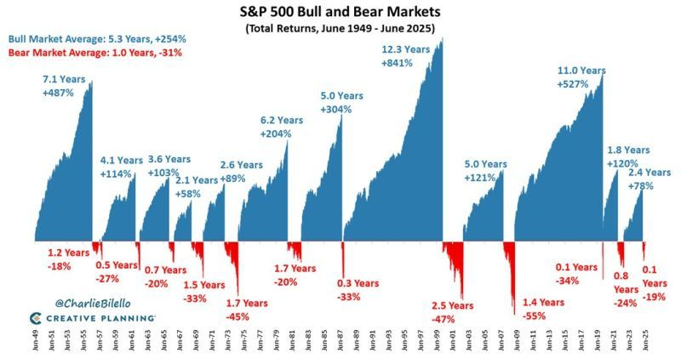

Slide 62
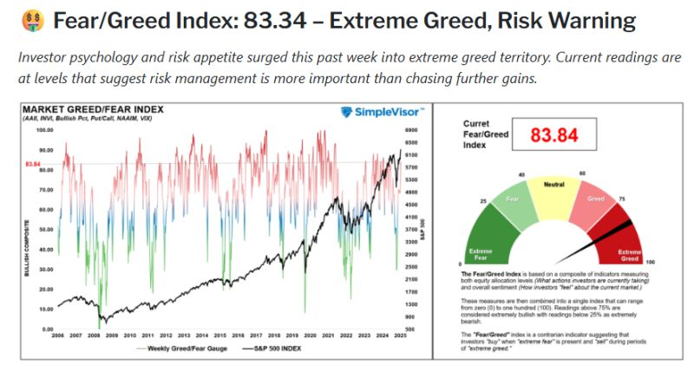
Greed is on…

Slide 63
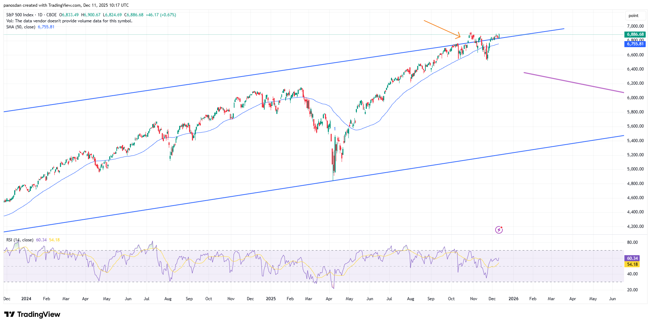
SPX , Daily

Slide 64
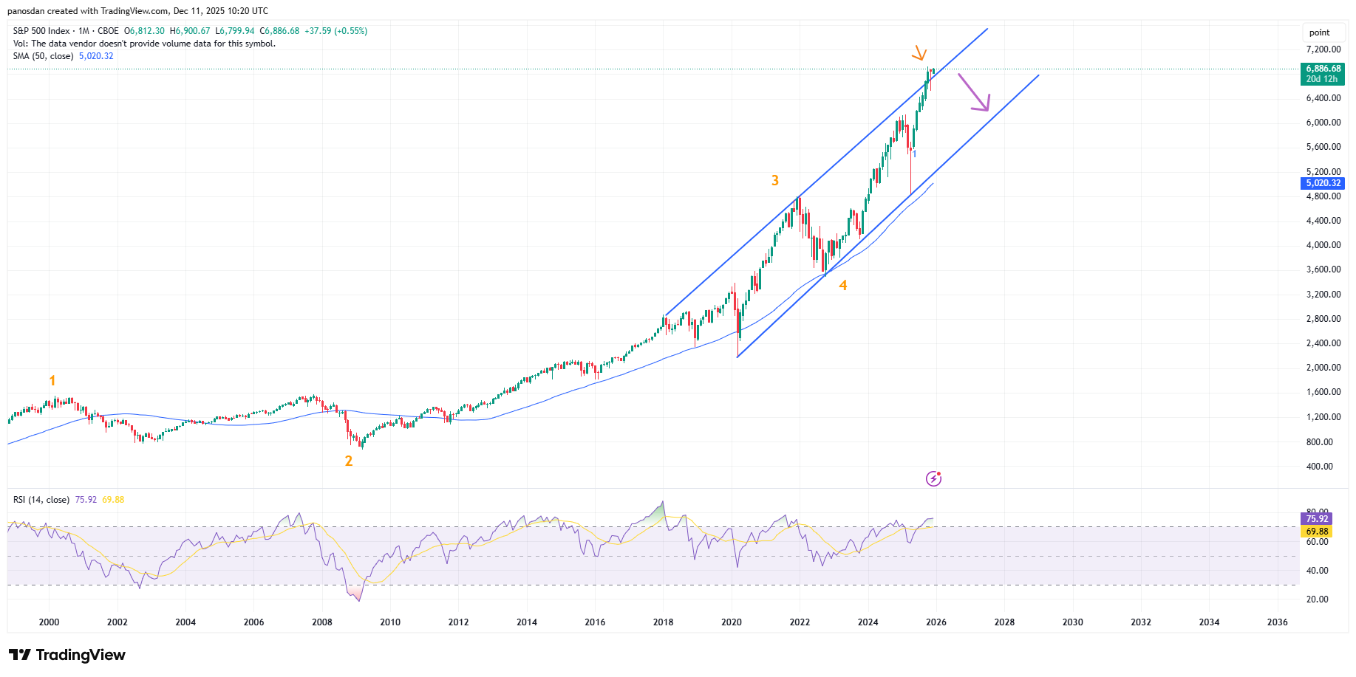
SPX , Monthly

Slide 65
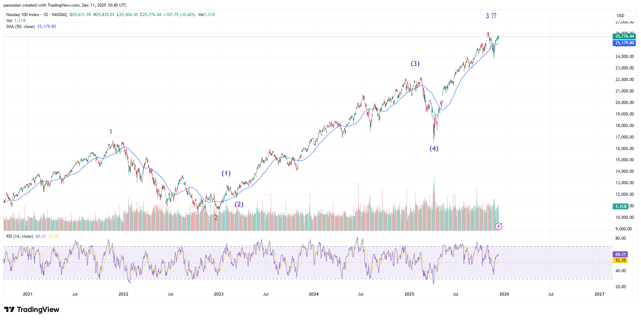
NDX, Daily

Slide 66
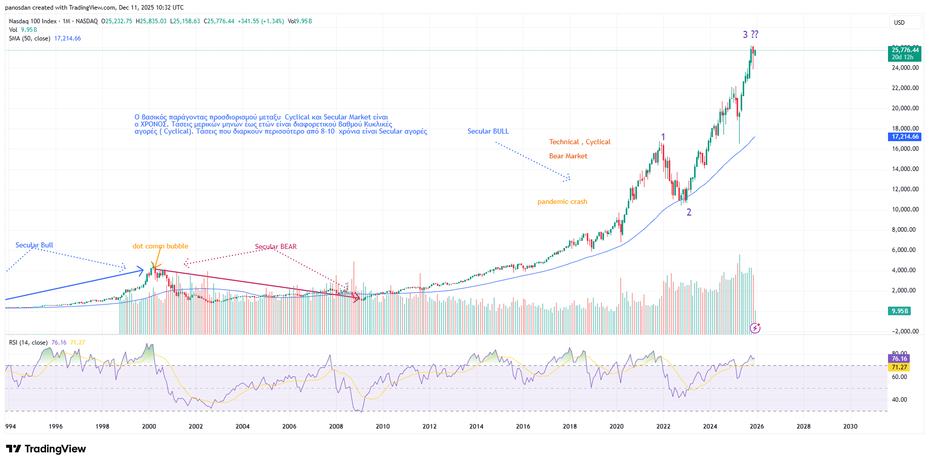
NDX, Monthly

Slide 67
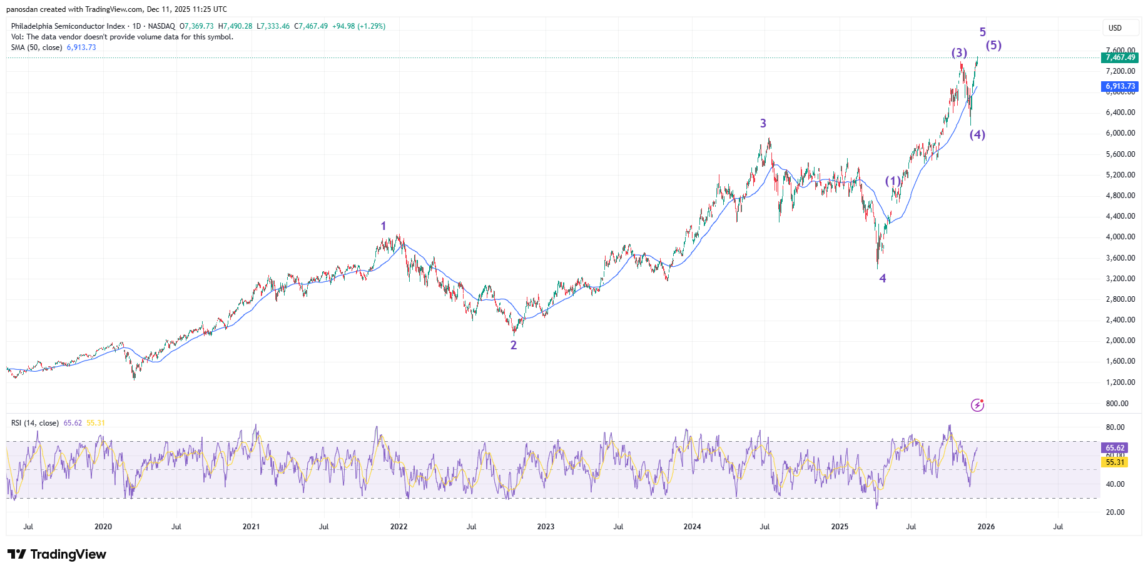
SOX , Daily

Slide 68
Διεθνείς Οίκοι, Εκτιμήσεις 2026
Solidus Sec

Slide 69
Stocks
Morgan Stanley:
  Γενική Σύσταση: Overweight (Υπεραπόδοση) στις μετοχές, με ισχυρή προτίμηση στα περιουσιακά στοιχεία των ΗΠΑ.
  Προοπτικές ΗΠΑ: Αναμένεται ότι οι μετοχές των ΗΠΑ θα υπεραποδώσουν έναντι των παγκόσμιων, με τον δείκτη S&P 500 να προβλέπεται να φτάσει τις 7.900 μονάδες (αύξηση 16% από το τρέχον επίπεδο) λόγω:
    Φιλικού προς την αγορά μείγματος πολιτικής.
    Μειώσεων επιτοκίων από την Federal Reserve.
Ανάπτυξης κερδών και ταμειακών ροών.
Γενικές Παρατηρήσεις:
  Οι Ευρωπαϊκές και Αναδυόμενες Αγορές αναμένεται να έχουν πιο συγκρατημένη απόδοση λόγω πιο αδύναμων προβλέψεων ανάπτυξης.
  Η Ιαπωνία έχει πιο θετικό αφήγημα λόγω των δημοσιονομικών και ρυθμιστικών μεταρρυθμίσεων.
J.P. Morgan:
  Τεχνολογία/AI: Βλέπει μια ισχυρή ευκαιρία που δημιουργείται από τον κύκλο καινοτομίας της Τεχνητής Νοημοσύνης (AI), η οποία οδηγεί την παραγωγικότητα και τα εταιρικά περιθώρια κέρδους. Οι δαπάνες σε υποδομές AI προβλέπονται να είναι τεράστιες.
  Ευρωπαϊκό Λογισμικό: Η Bernstein (αναφέρεται σε σχετικό άρθρο) ξεχωρίζει ευρωπαϊκές εταιρείες λογισμικού, με κορυφαία επιλογή την SAP (σύσταση Outperform) λόγω διψήφιας αύξησης εσόδων και επέκτασης περιθωρίων κέρδους.

Slide 70
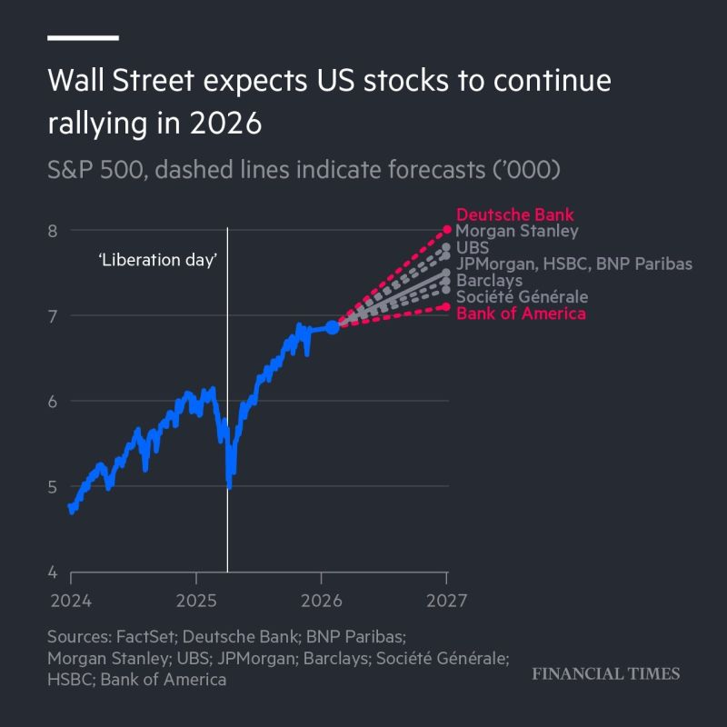
Wall Street expects US stocks to continue rallying in 2026
1. Earnings expectations remain the anchor.
Analysts still expect profit growth through 2025–26, particularly in tech, healthcare and services. But assumptions around AI-linked productivity gains differ widely, which explains much of the spread in targets.
2. Monetary policy uncertainty persists.
A slower Fed cutting cycle, combined with stickier components of inflation, creates a broader range of possible equity outcomes. Higher-for-longer rates don’t end the rally — they just flatten its trajectory.
3. Positioning and flows continue to support risk assets.
US equities remain the global benchmark for capital deployment. Foreign inflows have strengthened post-election, and the absence of recession signals in leading indicators gives markets breathing room.
4. But valuation limits are real.
Even the most bullish houses acknowledge that further upside will require earnings delivery, not just multiple expansion. The easy phase of the rerating is behind us.
=> These forecasts aren’t a victory lap. They’re a reflection of a market transitioning from a policy-driven bull run to an earnings-driven one.

Slide 71

BONDS : depends on rate cuts
Morgan Stanley:
  Γενική Σύσταση: Equal-weight (Ουδέτερη/Ίση Απόδοση) στα σταθερού εισοδήματος (Fixed Income), δηλαδή στα ομόλογα.
Προοπτικές:
  Η προσδοκία για μειώσεις επιτοκίων από την Federal Reserve θα μπορούσε να υποστηρίξει τις τιμές των ομολόγων.
  Ομόλογα Υψηλής Φερεγγυότητας (Investment Grade) και Ομόλογα Συνδεδεμένα με τον Πληθωρισμό (Inflation-Linked Bonds) προτείνονται για ανθεκτικότητα σε χαρτοφυλάκια (σύμφωνα με παλαιότερη ανάλυση της Alpha Bank για το 2025, που μπορεί να συνεχίσει να ισχύει).
Ελληνικά Ομόλογα:
  Η ανάκτηση της επενδυτικής βαθμίδας συνεχίζει να προσελκύει σημαντικό επενδυτικό ενδιαφέρον, με τις προσφορές να παραμένουν υψηλές.
  Στην ελληνική αγορά, υπάρχουν εταιρικά ομόλογα με ημερομηνίες λήξης γύρω στο 2026-2027 (π.χ., AEGEAN, CPLP, ορισμένα της ΓΕΚ ΤΕΡΝΑ), καθώς και αμοιβαία κεφάλαια εισοδήματος με στόχο το 2026.

Slide 72
Commodities : overweight on geopolitical risks and energy transition
Πολύτιμα Μέταλλα
Χρυσός (Gold): Αναμένεται να παραμείνει ένας ισχυρός αντισταθμιστικός παράγοντας έναντι του πληθωρισμού, της ύφεσης, της υποτίμησης νομισμάτων και των πολιτικών κινδύνων.
  Goldman Sachs/Deutsche Bank/J.P. Morgan: Πολλοί ειδικοί προβλέπουν περαιτέρω άνοδο της τιμής, με κάποιες εκτιμήσεις να φτάνουν στα $5.500 έως τα μέσα του 2026 ή ακόμα και στα $6.000 ανά ουγγιά.
  Κύριοι Λόγοι: Συνεχιζόμενες αγορές από Κεντρικές Τράπεζες και μεγάλα δημοσιονομικά ελλείμματα.
UBS: Βλέπει περαιτέρω κέρδη για τον χρυσό, υποστηριζόμενα από αγορές κεντρικών τραπεζών και χαμηλότερα πραγματικά επιτόκια στις ΗΠΑ.
Βιομηχανικά/Ενέργεια
UBS: Προβλέπει ελκυστικές αποδόσεις στα εμπορεύματα, συστήνοντας μια ευρύτερη έκθεση, με ιδιαίτερη έμφαση:
  Χαλκός & Αλουμίνιο: Αναμένονται περαιτέρω ελλείψεις προσφοράς που θα αυξήσουν τις τιμές. Η παγκόσμια στροφή στην καθαρή ενέργεια και η ηλεκτροκίνηση οδηγούν τη ζήτηση για αυτά τα μέταλλα.
  Πετρέλαιο: Αναμένεται αύξηση των τιμών από τα μέσα του 2026 λόγω της ανάκαμψης της ζήτησης και της στασιμότητας της προσφοράς από χώρες εκτός OPEC+.
  Γεωργικά Προϊόντα: Βλέπει ευκαιρίες και στον τομέα της γεωργίας.
Παγκόσμια Τράπεζα (World Bank):
  Πιο συντηρητική πρόβλεψη, εκτιμώντας ότι οι γενικοί δείκτες τιμών εμπορευμάτων μπορεί να φτάσουν στα χαμηλότερα επίπεδα των τελευταίων έξι ετών το 2026 (πτώση 7% το 2026), λόγω αδύναμης παγκόσμιας ανάπτυξης και πλεονάσματος πετρελαίου. Ωστόσο, σημειώνεται ότι τα μέταλλα και τα πολύτιμα μέταλλα έχουν ενισχυθεί.

Slide 73
JPMorgan
JPMorgan Chase & Co forecast the S&P 500 could climb to 7,500 by the end of 2026, and potentially exceed 8,000 if the Federal Reserve eases monetary policy more aggressively than expected, according to its 2026 Global Equity Outlook.
The bank’s baseline projection assumes two additional Fed rate cuts and 13% to 15% annual earnings growth for US companies, underpinned by a resilient economy and an investment surge in artificial intelligence technology. JPMorgan highlighted an AI-driven “capex supercycle” as a key factor supporting elevated valuations.
"Despite AI bubble and valuation concerns, we see current elevated multiples correctly anticipating above-trend earnings growth, an AI capex boom, rising shareholder payouts, and easier fiscal policy," the firm said in a client note published Tuesday. "More so, the earnings benefit tied to deregulation and broadening AI-related productivity gains remain underappreciated."
The firm warned, however, that rapid AI disruption could exacerbate economic inequalities and contribute to volatile investor sentiment in an already K-shaped economy.
JPMorgan’s forecast follows data showing S&P 500 companies grew earnings by 13.4% in the third quarter from a year earlier, according to FactSet. The bank sees continued US growth as a primary engine for global equity gains, alongside easing policy pressures and strong shareholder payouts.
Markets were pricing in an 85% chance of a Fed rate cut next month as of Wednesday morning. JPMorgan said that further easing, coupled with an improving inflation outlook, could lift the index beyond its baseline 7,500 target toward 8,000.

Slide 74
Goldman Sachs
Our overall outlook is constructive for the year ahead, yet risks abound. Stronger than expected growth or inflation could disrupt the
path for Fed cuts. Earnings, which underpin our global equity views, could disappoint. Geopolitical and cyclical shocks are real
possibilities. Valuations are high across almost all markets, inviting episodic volatility and periodic pullbacks. With all this in mind, we are approaching 2026 through three key themes across equities, fixed income, and alternatives
"We see attractive global equity returns driven by economic and earnings growth, improved productivity and profitability, and strong shareholder returns"
"US short rates will be shaped by new Fed leadership that may enable more aggressive easing, while a divided FOMC could introduce more uncertainty"
"Expect oil prices to decline as surplus supply persists.
Gold may continue to attract strong flows, driven by macro vulnerabilities, deficit concerns,
and dollar weakness"

Slide 75
CONTRARIAN thoughts..
JPM says SPX could reach 8,000 in 2026 with Fed easing
Traders : “When JPM starts pumping the market it often means they are preparing to unwind positions in key tickers, possible ORCL, NVDA, GOOG, AMZN, PLTR and others. The impact usually shows up the following month or two.”

Slide 76
2026 Portfolio -1
ΗΠΑ (US) - Οδηγός Ανάπτυξης
Οι ΗΠΑ παραμένουν η κορυφαία επιλογή των περισσότερων οίκων για το 2026, κυρίως λόγω της κυριαρχίας τους στην τεχνολογία και της αναμενόμενης αποκλιμάκωσης του πληθωρισμού.
Μετοχές
Κορυφαίοι Κλάδοι (Overweight):
  Τεχνολογία (Technology) & Επικοινωνίες (Communication Services): Η J.P. Morgan και η Goldman Sachs τονίζουν ότι η επανάσταση της Τεχνητής Νοημοσύνης (AI) βρίσκεται ακόμα στην αρχή. Προβλέπονται μεγάλες επενδύσεις σε υποδομές AI, cloud computing και ημιαγωγούς. Η σύσταση είναι Overweight στις "Magnificent Seven" (π.χ., Nvidia, Microsoft, Amazon), παρόλο που έχουν ήδη υψηλές αποτιμήσεις, καθώς η ανάπτυξη των κερδών τους δικαιολογεί το premium.
  Υγεία (Healthcare): Θεωρείται αμυντικός κλάδος, με ισχυρή ταμειακή ροή και ανθεκτικότητα σε οικονομικές επιβραδύνσεις.
Υπο-απόδοση (Underweight):
  Βιομηχανία (Industrials): Αναμένεται επιβράδυνση της παγκόσμιας ζήτησης.
  Ενέργεια (Energy): Παρόλο που το πετρέλαιο μπορεί να ανακάμψει, η μακροπρόθεσμη τάση της ενεργειακής μετάβασης ασκεί πίεση.
Προβλέψεις S&P 500: Οι στόχοι των αναλυτών κυμαίνονται μεταξύ 6.900 και 7.900 μονάδων για το τέλος του 2026.
Ευρωπαϊκή Ένωση (EU) - Ευκαιρίες σε Αμυντικούς Κλάδους
Η Ευρωπαϊκή Ένωση αντιμετωπίζει πιο αργή ανάπτυξη σε σχέση με τις ΗΠΑ, αλλά προσφέρει πιο λογικές αποτιμήσεις και ευκαιρίες σε συγκεκριμένους κλάδους.
Μετοχές
Γενική Σύσταση: Equal-weight (Ουδέτερη) έναντι των ΗΠΑ.
Κορυφαίοι Κλάδοι (Overweight):
  Λογισμικό/Τεχνολογία (Software): Επιλεγμένες εταιρείες λογισμικού (όπως SAP) βρίσκονται σε καλό δρόμο για ανάπτυξη λόγω της μετάβασης σε μοντέλα SaaS και cloud.
  Χρηματοοικονομικά/Τράπεζες (Financials): Οι ευρωπαϊκές τράπεζες είναι σε ισχυρότερη θέση λόγω των υψηλότερων επιτοκίων που αύξησαν τα περιθώρια κέρδους τους (NII - Net Interest Income). Αναμένονται ελκυστικές επιστροφές κεφαλαίου (μερίσματα και επαναγορές μετοχών).
  Υποδομές/Βιομηχανικά Αγαθά: Εταιρείες που επωφελούνται από τα έργα της πράσινης μετάβασης (π.χ. ανανεώσιμες πηγές ενέργειας, δίκτυα διανομής).
Υπο-απόδοση (Underweight):
  Κατασκευές/Ακίνητα: Ο κλάδος έχει πληγεί από τα υψηλά επιτόκια και τις τιμές των υλικών.

Slide 77
2026 Portfolio -2
Ελλάδα - Συνέχιση της Υπεραπόδοσης
Η Ελλάδα, έχοντας ανακτήσει την επενδυτική βαθμίδα, συνεχίζει να θεωρείται "success story" και να προσελκύει αυξημένες θεσμικές ροές κεφαλαίων. Οι οίκοι αναμένουν συνέχιση της υπεραπόδοσης του ελληνικού χρηματιστηρίου (FTSE/ATHEX).
Μετοχές
Γενική Σύσταση: Overweight (Υπεραπόδοση) σε σχέση με τις Αναδυόμενες Αγορές και τις υπόλοιπες περιφερειακές αγορές της ΕΕ.
Κορυφαίοι Κλάδοι & Μετοχές (Overweight):
  Τράπεζες (Banks): Μετά την αναδιάρθρωση, οι ελληνικές τράπεζες (π.χ., Εθνική Τράπεζα, Alpha Bank, Eurobank, Πειραιώς) βρίσκονται σε θέση να επιστρέψουν σημαντικά μερίσματα και να προχωρήσουν σε επαναγορές, ενώ τα NII παραμένουν σε υψηλά επίπεδα. Οι αναλυτές βλέπουν περιθώριο περαιτέρω αύξησης των τιμών των τραπεζικών μετοχών λόγω της αναβάθμισης της ποιότητας των περιουσιακών στοιχείων.
  Ενέργεια (Energy) & Καθαρή Ενέργεια: Εταιρείες που ηγούνται της πράσινης μετάβασης (ΔΕΗ, Mytilineos) και έχουν ισχυρή παρουσία στο εξωτερικό. Η Mytilineos ξεχωρίζει συχνά λόγω του διαφοροποιημένου χαρτοφυλακίου της (Clean Energy & Metals).
  Τουρισμός/Μεταφορές: Εταιρείες με ισχυρό τουριστικό αποτύπωμα (ΟΠΑΠ, Αεροπορικές κ.λπ.) λόγω της ανθεκτικότητας του ελληνικού τουρισμού.
Προβλέψεις: Οι εκτιμήσεις τοποθετούν τον Γενικό Δείκτη του ΧΑ σε επίπεδα 2.300+ μονάδων μέχρι το τέλος του 2026.
Ομόλογα
Ελληνικά Κρατικά Ομόλογα: Αναμένονται περαιτέρω μειώσεις στις αποδόσεις, καθώς το spread έναντι του γερμανικού ομολόγου (Bund) θα συνεχίσει να στενεύει. Η Morgan Stanley και η UBS προβλέπουν μεγαλύτερες ξένες εισροές στα ελληνικά ομόλογα.
Ομόλογα & Εμπορεύματα
Ομόλογα: Προτίμηση σε Μεσοπρόθεσμα ομόλογα ΗΠΑ, καθώς οι μειώσεις επιτοκίων της Fed θα ωθήσουν τις αποδόσεις χαμηλότερα, με αποτέλεσμα την αύξηση της τιμής των ομολόγων.
Εμπορεύματα: Συστάσεις για Χρυσό (Gold) ως αντιστάθμισμα κινδύνου.

Slide 78
Solidus Focus List
US
AVGO - Designs and supplies a range of semiconductors , enterprise software and security solutions
INTC - Most advanced chip maker with major stakeholders.
Nvidia (NVDA) — High-conviction “franchise pick” at Jefferies for AI infrastructure dominance.
Arista Networks(ANET) - Network Infrastructure Crucial enablement role in massive AI buildout
Alphabet (GOOG / GOOGL) — Growth stock highlighted among best to own in 2026
Walmart (WMT) — Included in CIO 2026 “top six” for retail + AI-driven growth.
AMD — Positioned to benefit from AI demand shift into inferencing hardware.
CrowdStrike (CRWD) — Leading cybersecurity firm riding AI/security trends
Quanta Services (PWR) — Power infrastructure poised for electrification demand.
Linde (LIN) - Basic Materials/IndustrialsBenefiting from capex surge/on-shoring trends
ServiceNow (NOW)Information Technology (AI 2.0/Software)Enterprise adoption facilitating productivity gains
OKLO - provide clean, reliable energy at scale
SMR – Small modular reactor nuclear technology
Europe
ASML Holding (Netherlands) — Semiconductor equipment leader, upgraded to Buy for long-term growth.
AXA (France) — Buy recommendation with attractive dividend potential.
UBS - Highlighted by JPMorgan for its exceptional cost discipline, keeping cost growth contained at 2% to 3%, significantly below the 5% to 10% increases seen among US peers.
Barclays Plc (BARC): Recommended as a deep-value stock, trading at approximately seven times earnings, substantially cheaper than US rivals like Goldman Sachs (15x earnings).
NN Group (Netherlands) — Strong earnings growth outlook.
Siemens Energy — Renewable power & grid tech
Rheinmetall AG / BAE Systems — Defense spend beneficiaries
Novo Nordisk, AstraZeneca — Healthcare growth via innovative drugs
LVMH, Hermès — Luxury demand resilience
Asia
Taiwan Semiconductor (TSM) — Standout Asia-linked chip powerhouse on top global stock lists.
Japan Nikkei 225 ETF
India ETF

Slide 79
Solidus Focus List - XA
ΕΤΕ
ΠΕΙΡ
BOCHGR
ΕΛΧΑ
ΔΕΗ
ΜΥΤΙΛ
TIT
ΕΛΠΕ
ΟΠΑΠ
AKTR
ΠΛΑΘ
ΙΝΤΕΚ
ΠΡΟΦ
ΑΕΜ
ΕΥΔΑΠ
ΑΣΚΟ

